Slide 1


TestifAI: A Comprehensive Testing Framework for Safe AI Arooj Arif ¹, Alexandros Koliousis¹, Elena Botoeva² ¹Northeastern University, ²Kent University
London Hopper Colloquium 2024
Research Spotlight Competition
Notes:
Hello everyone,
My name is Arooj Arif, and I am here to present my research focuses on to make sure that AI systems are safe and reliable, especially in safety critical systems Let's explore why this is so important.
1

Slide 2
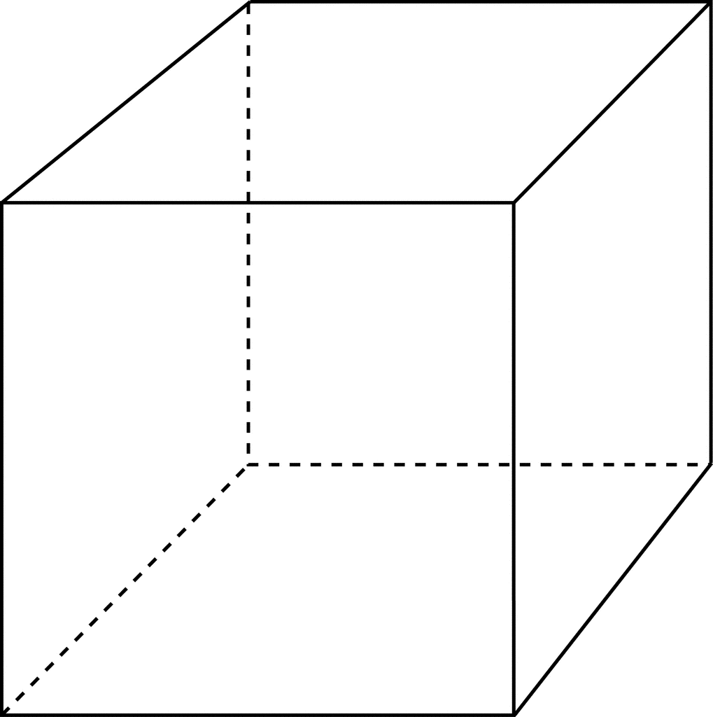
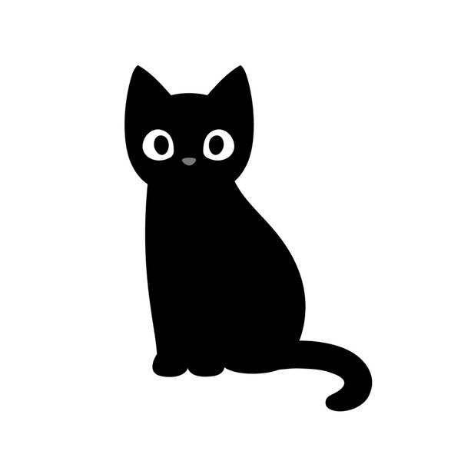

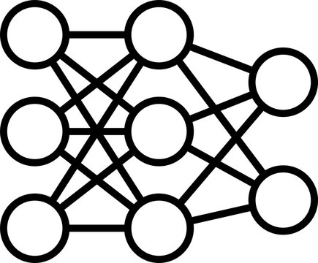


Enhancing Safety in AI: The Urgency of Thorough Testing
AI is used in safety critical systems (healthcare, automotive, avionics).
Neural Networks are sensitive to perturbations.
Perturbed Value
$$ε$$
DOG
Original Pixel
CAT
NN
NNs, just like standard programs, need to be tested for correctness.
Core Challenge: How to test an AI System thoroughly?
London Hopper Colloquium 2024
Research Spotlight Competition
Notes:
In the past few years, AI has made amazing progress in many critical fields. For example, we now have self-driving cars that can make quick decisions and robots that can perform surgeries.
But even though these technologies are impressive, we don't see them used everywhere in our daily lives. The reason is that these AI systems sometimes fail. Self-driving cars have crashed, and some healthcare algorithms don't work well for everyone.
These failures show us why it's so important to thoroughly test AI systems to ensure they are safe and reliable.
One of the main challenges in testing AI systems is their use of neural networks. Neural networks are a type of AI model that can learn and make decisions, but they are very sensitive to changes. For example, in this image if we change few pixels of cat model predict it dog. This sensitivity makes it hard to ensure their robustness – that is, their ability to handle different conditions without failing.
And that's what our research is all about

Slide 3
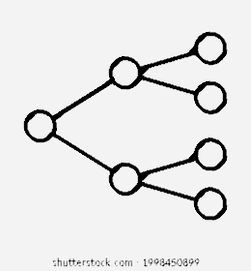


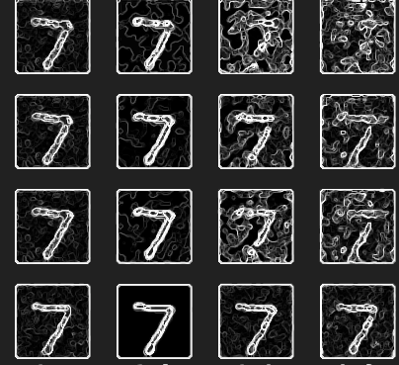

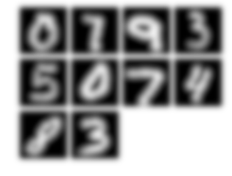
A Comprehensive Testing Framework for AI Systems
A conceptual framework that includes:
An end-to-end pipeline
An error summarization approach for model refinement
Local and global correctness
Specifications
Sampling
Testcase Generation
Testing
Error Summarization
clearly define all necessary properties of the system
gather all relevant samples necessary for thorough model testing
generate different testcases according to the specified properties
assessing local and global correctness
graphical error reports and recommendations for model refinement.
Rotation
Noise
….
Brightness
London Hopper Colloquium 2024
Research Spotlight Competition
3
Notes:
To solve these problems, we developed 'TestifAI,' a complete testing framework for AI systems. Our framework includes:
Specifications: Clearly defining what the AI system needs to do.
Sampling: Collecting all the data needed for testing.
Testcase Generation: Creating different test scenarios, according to the specifications that what are the sceniores we have to test
Testing: Checking both small and big picture correctness.
Error Summarization: Providing visual reports and suggestions for improvement.
This process ensures that AI models are thoroughly tested before they are used, reducing the chances of failures.

Slide 4

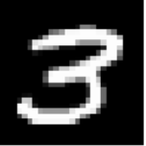

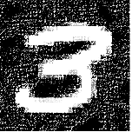
AI System: The Sum of two Digits using an MNIST Classifier
Maximum probability of correct answer for this pair
MAX(GL_{n}, GL_{r}) = 0.43
+
= 12
Minimum probability
MIN(GL_{n}, GL_{r}) = 0.23
Optimistic view
Pessimistic view
+
= 12
+
= 12
GL_{n} = LO_{n}(9) * Lo_{n}(3) = 0.43
GL_{r} = LO_{r}(9) * Lo_{r}(3) = 0.23
Global Correctness
9 |
3 |
9 |
3 |
…
…
…
…
LO_{n}(9) = 0.66
LO_{n}(3) = 0.65
LO_{r}(9) = 0.46
LO_{r}(3) = 0.50
Local Correctness
…
…
…
…
Noise property
Rotation property
Notes:
Now, let's dive into one of the key experiments we conducted using our framework.
Imagine an AI system that sums two digits. For example, if the digits are 9 and 3, the system should give us the sum, which is 12.
First, the system predicts each digit. So, in our example with 9 and 3, the system needs to correctly identify these digits before adding them together.
We measured local correctness, which checks how accurately the system predicts each individual digit. For example, if the system correctly identifies 9 and 3 with certain probabilities, we can see how confident it is in these predictions.
Next, we calculated the overall performance, known as global correctness. This looks at the AI's accuracy across all digit pairs. In our example, the system might be 43% confident that the sum is correct under one condition (like rotated images) and only 23% confident under another condition (like noisy images).
These probabilities show us the system's performance in different scenarios. The optimistic value (43%) is the best-case scenario, and the pessimistic value (23%) is the worst-case scenario. This helps us understand how reliable the system is under various conditions.
Our framework also helps identify which specific digits are causing problems. If the global correctness is low, we can trace it back to see if the issue is with certain digits, like 9 or 3, under specific conditions. This detailed analysis allows us to improve the system's robustness by addressing these specific weaknesses.
The flexibility of our framework means it can be applied to different types of data and scenarios. This ensures that AI systems are thoroughly tested and reliable in various real-world conditions.
, this experiment highlights the core contribution of our work: a detailed and adaptable framework that thoroughly tests AI systems to ensure their accuracy and robustness.

Slide 5
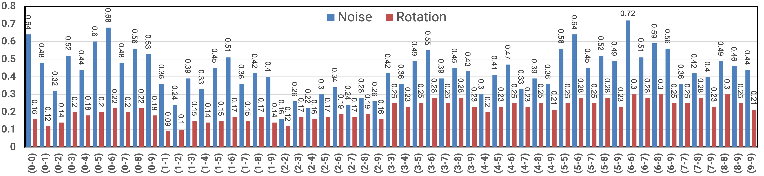
Evaluation for the Sum of two Digits on 1000 samples
We tested 55 unique pairs {d₁, d₂} for 0 ≤ d₁, d₂ ≤ 9
For each pair {d₁, d₂}, the digits were sampled randomly from the corresponding class
We computed the minimum probabilities for each pair (L₁, U₁), …, (L₅₅, U₅₅)
The global pessimistic correctness is 9%
The global optimistic correctness is 72%
London Hopper Colloquium 2024
Research Spotlight Competition
5
Notes:
Let me share some results from our framework. We tested an AI system that sums two digits using the MNIST dataset.
We tested 55 unique pairs of digits, randomly selecting samples from each class. For each pair, we calculated the chances of correct answers under different conditions.
Our results showed that the lowest chance of correct answers was 9%, and the highest was 72%. While there's still room for improvement, our framework significantly improves the reliability of AI models.
Through this thorough testing approach, we aim to bring the benefits of AI safely into everyday life.
5

